Slide 1

Managing Through Change
Quarterly Provider Training Series
February 16, 2023
Notes:
Staci
Good afternoon, welcome to everyone that has joined us this afternoon.
This is the first quarterly training of 2023 of the Minnesota Transformation Initiative. Today's topic is Managing Through Change.
My name is Staci jones, an associate with the institute for community inclusion at University of Massachusetts boston. (or ICI umass for short)
Before we kick things off, just a few housekeeping items. We ask that all participants remain on mute throughout the presentation, in order to reduce background noise.
We will have team members monitoring the chat for any questions that may arise. You are welcome to type questions in the chat at anytime, and will be reading out questions to our guest presenters today will be taking time to answer questions at the end instead of taking questions throughout the presentation.
Today’s session is being recorded and that recording, along with the presentation slide deck will be sent out via email to anyone that registered for this webinar. You will also find a copy of the today's PPT in the chat box available for immediate download.

Slide 2


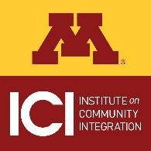


MTI Landing Page: https://mti.ici.umn.edu/
• About
• Recordings
• Registration
• Resources
Notes:
For anyone just joining us for the first time, Just a quick reminder that the Minnesota Transformation Initiative is made possible through a grant from the Minnesota Department of Human Services and is in partnership with Institute on Community Integration at University of Minnesota as well as ICI at Umass Boston, Strengths at Work, LLC, the Arc of Minnesota and Quillo. This initiative is designed to help organizations move away from supporting employment that pays subminimum wage and expand competitive integrated employment and community life engagement outcomes.
Part of the MTI project includes the opportunity to put on these quarterly trainings, where we focus on themes related to organizational transformation and best practices in employment and community services. This webinar series is also brought to you in partnership with Minnesota MOHR.
And also want to point out that the MTI project has a web-based landing page, and you can access that landing page at the web address on the screen. The PDF of the PPT includes a hyperlink that you can click on. On that landing page you'll find more information about the project as well as resources, you can register for upcoming trainings and recordings of past trainings. I’m going to turn things over to my colleague Brian to take things from here.

Slide 3

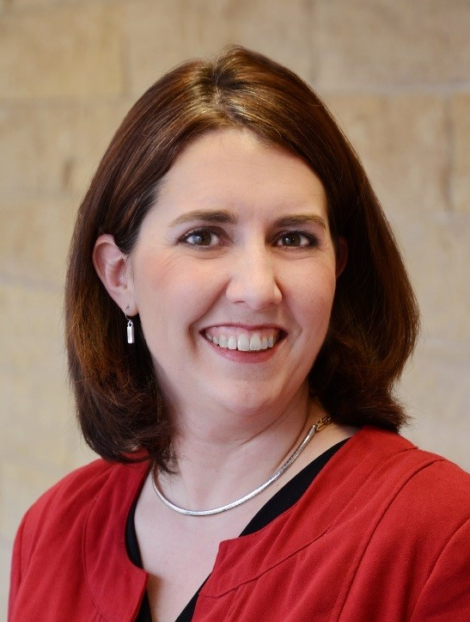
Introductions
Tim Schmutzer
Executive Director
PHASE-Industries
Tami Reuter
Chief Business and Marketing Officer
MRCI
Notes:
Brian
(introduce yourself)
For today's topic of Managing through change, we are thrilled to have with us 2 organizational leaders who will be sharing a little bit about their organizations' transformation stories and how they successfully manage through the ups and downs and challenges that come along with transformation.
Our first presenter today is Tim Schmutzer, Executive Director for PHASE-Industries, operating out of east-central Minnesota. Tim has spent two decades working in and providing consultation to nonprofit human service, transportation and other healthcare systems to stabilize, build, diversify, and successfully align & merge entities. Tim completed his postgraduate education in counseling psychology and neuroanatomy at University of Wisconsin-Madison. He is a certified practitioner of the Myers Briggs Type Indicator (MBTI) Instrument, a graduate of the Minnesota Council of Nonprofits Leadership Institute, and actively participates on local economic development authorities and several regional & statewide boards of directors.
Also joining us today is Tami Reuter. Tami serves as Chief Business and Marketing Officer for MRCI, out of Mankato. Reuter’s focus in the nonprofit industry includes work on developing the talents of the future workforce. Her past professional roles as Executive Director of South-Central College’s North Mankato Campus Foundation and Vice President of Operations for Junior Achievement were firmly grounded in developing the potential of others. Tami also finds inspiration from many of the organizations she personally supports with her contributions of time including the YWCA, PEN, Greater Mankato Growth, St. John’s church and several others.

Slide 4
Poll #1
What is your role?:
Senior leadership
Mid-manager
Employment Staff
Residential staff
Day Staff
Case Manager
Other
Notes:
Brian
Before I pass things over to Tim, we want to start by taking a quick poll to find out about who is joining us for today's training.
We just would like to know what is your primary role. You'll have the option to choose between Senior Leadership, mid-manager, employment staff, residential staff, day services staff, Case Manager, or other. And we know that at non-profit organizations it is common to have multiple roles, so just choose the one that you think most closely aligns. If none of these fit, then just choose other and feel free to type your role into the chat box.
Now, I'll hand things over to Tim.

Slide 5

Organizational Transformation:
Intersection of Leadership, Culture & Purpose in Transformation
Tim Schmutzer, CEO
PHASE-Industries
“People don’t buy what you do, they buy why you do it.”
--Simon Sinek

Slide 6
Session Objectives:
Provide framework for approaching the activities in the first two Essential Elements of Provider Transformation.
Clarify a key, but often missing, component in shaping a culture of excitement, change, inclusion & purpose.
Practical examples of false starts, course corrections & lessons learned by PHASE-Industries in its on-going transformation journey.
Highlight the call for & role of leadership in transformation.

Slide 7
10 Essential Elements of Provider Transformation
Leadership, Focus & Values
Clear and consistent goals
Agency culture supports inclusion
Employment Practices & Community Life Engagement
Customer focus & engagement
A holistic approach
Active person-centered job development
Infrastructure, Operations & Finance
Reallocated, restructured resources
Strong communication plan
Ongoing staff development
Performance measurement & QA
Diverse community partnerships
www.thinkwork.org

Slide 8

Revisit Mission & Vision….
First, though, know & articulate why you do, or want to do, what your Mission & Vision lay out.
  Personally & Organizationally
  Informs clarity in values
  Creates a lens through which Mission/Vision are crafted, re-crafted & revealed.
  Acts as essential building block in shaping the culture of the organization.
  Supports development of clear & consistent goals.
  Creates workforce alignment, along with a non-threatening exit path for those not aligned.
Focus and Values
Element #1: Clear and consistent goals
Element #2: Agency culture supports inclusion

Slide 9
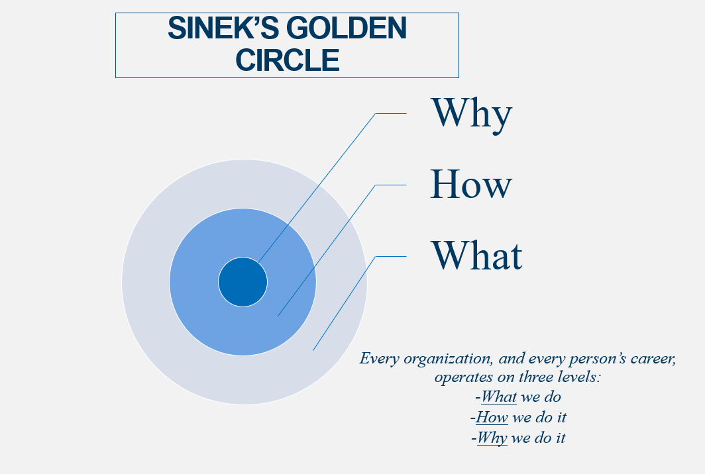


Slide 10
A Case for Answering the “Why”
Mission, Vision, Values
Let your “Why” lead the way…
Mission Statement – Too often include only what you do and how you do it. Even when purpose statement is included, it can be lackluster and uncompelling.
Vision Statement – aspirational: the future ideal state the organization wishes to achieve.
Value Statement – principles that guide the organization. Moral compass.
Creates a deep, inspirational & ultimately more influential value.
Activate the neural pathways that matter.
Injects passion into our work.
Expresses who we are when we are at our natural best.
Simple, clear, actionable, focused on effect you will have, and emotionally (physiologically) fulfilling.
Your “why” will permeate, influence, and become inherent in your Mission, Vision, Values and in every action of your Organization.
Some Statements with & without “Why” to consider…

Slide 11
PHASE-Industries: Lessons Learned in the Transformation Journey
Started with “What” and forgot the “Why”
Took some time to figure out how to engage the right people, at the right times, with the right questions & format, in a manageable way
More attention needed to effectively attend to the cycle of: Create clarity → Over-communicate clarity → Check & Reinforce clarity.
One act, one decision, one thing at a time—no person, and no organization, functions well in a constant state of frenzy, and confused or unlimited priorities.
Addressing some issues specific to small and rural communities.
Still learning & correcting course every day!

Slide 12
Leadership in Transformation
EVERYONE in the organization is a Leader!
Leaders inspire, and compel the translation of inspiration into action.
Don’t wait for leadership from the positions for groups expected to provide it (Execs, Boards, etc.). Leaders lead!
Balance leading from the “balcony” (big picture/systems thinking) and “in-the-weeds” (day-to-day/operational).
How do your observations inform your leadership, work and strategy? How do you collect, process, categorize and use your observations as a leader?
Have you discovered and articulated your own Why? If not, perhaps explore Simon Sinek’s book, Find Your Why.
Everything, every organization & everybody are in a constant transformation. The choice isn’t whether or not you choose to transform. Rather, it is about how to interact and shape transformation.
Leadership Job #1: always tend to organizational culture – the collection of values, expectations, and practices that guide and inform the behaviors, interactions & actions of all team members. Nothing permanent occurs unless the culture permits & reinforces it!

Slide 13
Organizational Transformation
Managing Successfully Through Organizational Transformation and Change
Tami Reuter, Chief Business & Marketing Officer, MRCI
Nate Lotton, Director of Employment & Day Services, MRCI

Slide 14
The MRCI Story
Rehabilitation program
for veterans/Polio victims
Center-based employment begins
Community employment
begins
1953
1960s
1980s
Notes:
Thank you for inviting me here today. Change happens all of the time around us. What drives the change? Before we reflect on the most recent transformation at MRCI I think it is important to realize that MRCI has been transforming for 70 years.
In simplest terms… It just so happens that in 2018 we embarked on a strategic journey, we were tasked with creating a plan that included some significant warning signs for our organization.
So who is MRCI?
let’s back up to 1953 when MRCI was founded by a concerned group of community members as an opportunity serve veterans and polio victims needing to rehabilitate to help on the family farm. Our mission than transformed in the 1960s when MRCI began center-based employment again in the 1980s when MRCI started working with our first clients as they found community-based employment. We all know the story of COVID in 2020, but out of that disaster became an opportunity to take the strategic plan created in 2018 off the shelf and create the New MRCI.
Where did we come from: 70 years of transformation
2018, the high-water mark
Reading the future, understanding Opportunities and the warning signs
Creating a plan for the future
COVID: turning disaster into opportunity
Creation of the “New MRCI”
MRCI today
What I have learned: Creating and Driving Organizational Change
Change Happens (all the time: good, bad and ugly)
What drives change?
Does change have to be dramatic?
Why is it hard to do something different?
What effect does your organizational culture have on change?

Slide 15
The “New” MRCI Menu of Services
Self-Direction Programs
Day Service Programs
Employment Services
Notes:
Today, We were very clear on who we are:
Our mission says we provide innovative and genuine opportunities for individuals with disabilities and disadvantages at home, at work and in the community. We do this now with a menu of services in Self Direction, Day Services and Employment Services.
We are an employment-first organization; however, are not an employment exclusive organization.
Specifically for our Employment Services, this meant for us an elimination of 14 c certificate and Enclaves. Our dream was that all of our clients who wanted to work would be proudly employed by employers in the community, on their payroll, wearing their company logo-wear and invited to their holiday parties. It seemed like a small dream, but the idea that our clients used to be sent away for holiday parties was going to be “win” for us in the inclusion category.

Slide 16

Organizational Transformation: Essential elements of successful organizational transformation:
INTERPRETED to “MRCI Jargon”
Notes:
Many of you are familiar with the 10 Elements of Successful Organizational Transformation to Competitive Integrated Employment. Over the next few minutes will share with you some of the successes and challenges in the last couple of years as we navigated our organizations transformation to community-based. Unfortunately, we will not have time to touch on all 10 elements; however, please know you are welcome to connect with me afterwards for additional information.
I’ve been told since the introduction of Microsoft TEAMS at MRCI that we can carry on full conversations using GIFS and EMOJI’s, but we won’t go to that extreme today. However, we are so transparent with these phrases they have become our own “language or Jargon” at MRCI that we introduce many of them during new hire orientation.
One of them that we use is “community-based” for us that means competitive, integrated employment as I mentioned early MRCI no longer as our 14c certificate or enclaves.

Slide 17

Clear and consistent goals
…Explain the Why (not the How)
Notes:
Let’s begin. One of the first elements is to have clear and consistent goals.
At MRCI, we had a strategic plan to be community-based. It was a 5-year plan written in 2018 to begin in 2019. The plan was very pretty. Thankfully, it did one think correctly as it provided all of the staff “the WHY” for the move to community-based.
However, We could have never predicted the pandemic.

Slide 18
We learned…
Have a road map
Communicate and explain the Why, not the How.
Empower your teams to create the How. They are your experts.
Over communicate, keep all channels open and listen!
Notes:
So, we learned
To Develop Your Plan or a road map (But Don’t Carve it in Stone – be ok with changing your course –it’s a journey of continuous improvements for the organization, each staff and each client)
Prepare a clear vision statement: why are we doing this? Communicate and explain the Why, not the How. Listen carefully to what people say and don’t say; how they react.
Empower your teams to create the How. They are your experts.
Identify your champions and your nay-sayers, include both in the planning
Over communicate, keep all channels open and listen! (We will touch on this more)

Slide 19

Agency culture supports inclusion
…Change is in our DNA
Notes:
Another Element: Agency Culture Supports Inclusion.
We reminded staff that change was part of our DNA. It’s always been part of who we are as an organization. If it wasn’t we would still be serving individuals with POLIO and non-exsistent. We focused on being proud of the work we are doing for the people we serve.

Slide 20
We learned…
Culture Before Strategy: Create a Culture Where Change is Normal and Expected
Who are your leaders and how do they react to change?
Flip your organizational chart to support innovation.
Who has the best ideas in your organization?
Do people in your organization have permission to experiment, try new things and share with others?
How are you celebrating new ideas and rewarding innovation?
Notes:
Culture Before Strategy: Create a Culture Where Change is Normal and Expected (Culture became one of our 5 measurable benchmarks as an organization).
Who are your leaders and how do they react to change?
* Is it Reactive change vs innovation driven change
Flip your organizational chart to support innovation
Who has the best ideas in your organization? Are you asking, are you listening?
Do people in your organization have permission to experiment, try new things and share with others? We talk about Failing Forward at MRCI.
Celebrate new ideas and reward innovation! (We do things such as inspire-a-thons)

Slide 21
An active, person-centered job placement process
…Challenge the barriers!
Notes:
Another Element: An Active, person-centered job placement process
Solution: Challenge the barriers.
Have the right people in the right seats.
We re-wrote job descriptions (and evaluated compensation) as on example.
Believe it or not, this can be fun.

Slide 22
We Learned…
Have the right people in the right seats.
Momentum is exciting
Have Courage
Notes:
Staffing is important with the right people in right people in the right seats.
We acknowledged that every client was unique; however, we every client who found a job it was exciting for everyone.
It took courage to stay no to crews/enclaves contracts, but it was affirming to see employers come back to us asking for help once they realized we were serious in our intentions.
Believe it or not, this can be fun.

Slide 23

A Strong Internal and External Communication Plan
Notes:
We were consistently facing an external message of “I thought MRCI was closed”, which impacted clients, families, case mangers the list goes on.

Slide 24
Communicate expectations often and to all
7 times…
In 7 ways
Notes:
We learned Communication is not a once and done.
Who do we need to communicate with? Make a list and a communication plan.
Listen to your feedback, read your cues and respond.
Our seven-time rule tells us to communication 7 times. However, during this transition we expanded this to not now say 7 times time, but to also say in 7 ways. So, diversify your communication techniques and make zero assumptions.
We were not perfect in our communications, we had numerous personal phone calls, meetings, emails, web, social media, newsletters, letters and we still have some segments are missing our messages. We attempt to be transparent and as mentioned previous always explain the why.

Slide 25
Reallocate and restructure all resources
…Fail Forward
Notes:
As we looked to reallocation and restructure resources this element one seemed to make a lot of sense. However, for us it was about Implementing, evaluate and refining. If it was not working, going back to the drawing board and finding a solution: In the easy approach it was about failing forward.
We didn’t give ourselves permission to do nothing or waiting for everything to be “perfect”, but we had permission to learn from what we were doing as long as we were moving forward.

Slide 26
Ongoing professional development of staff
…Innovative Inspirations
Notes:
We have numerous mission moments of our clients, but for us we looking for the innovative inspirations from our staff. Examples of our employees, at all levels providing meaningful ideas and energy to the mission. We created gateways for these with culture champions (monthly small group discussions) to inspire culture conversations. And friendly competitions, to inspire the creative and teamwork thinking around a problem with a inspire-a-thon competition.

Slide 27
Implementing the Plan, Considerate it a Journey
Hold true to your culture: everyone leads.
Be extremely agile and ready to re-group.
Celebrate success.
Enjoy the journey!
Notes:
In Summary as you are implementing your plan, which will be different than MRCI’s plan, consider it a journey.
Hold true to your culture: everyone leads.
Be extremely agile and ready to re-group.
Celebrate success.
Enjoy the journey!

Slide 28
Contact Tami Reuter & Nate Lotton
Email: treuter@mymrci.org
Phone: 507-386-5656
Email: nLotton@mymrci.org
Phone: 507-386-5636

Slide 29
Questions?
Notes:
Brian

Slide 30
Mark your calendars: Coming up in 2023
Next MTI Quarterly Training: Community Life Engagement
  5/25/23 at 1pm CT
MTI Landing Page: https://mti.ici.umn.edu/
• About the project
• Recorded trainings
• Registration
• Resources
Notes:
Brian

Slide 31
Additional Resources
Agency Change Toolkit: Ten elements of organizational transformation
Delphi panel findings
Provider experiences
Guidance for conversations: Identifying and designing pathways towards rewarding employment
State Employment Leadership Network

